Slide 1
Week 8
More SQL - Triggers

Slide 2
Student Objectives
Upon completion of this video, you should be able to:
List 3 reasons why triggers are useful
Identity the parts of a trigger
Trace SQL statements that use a trigger and determine what will be in the resulting tables

Slide 3
Triggers and Stored Procedures
Triggers are a set of SQL statements that execute when a certain event occurs in a table
Similar to a constraint but more powerful:
Example: a constraint will disallow a salary to go above a certain amount
A trigger can check how much the salary changes and if the change is above a certain amount, it can cause a user-defined function to notify an administrator about the change.
Almost all database management systems have triggers
Can help with the following:
If a business rule changes, you just need to change trigger not code
Improved performance (rules run on the server)
Global enforcement of business rules

Slide 4
Sample MySQL Trigger
9
delimiter //
CREATE TRIGGER upd_check BEFORE UPDATE ON account
FOR EACH ROW
BEGIN
IF NEW.amount < 0 THEN
SET NEW.amount = 0;
ELSEIF NEW.amount > 100 THEN
SET NEW.amount = 100;
END IF;
END;//
delimiter ;
1
2
3
4
6
8
5
 | Parts of the trigger
1 | Trigger Name (upd_check)
2 | Trigger activation time (BEFORE)
3 | Triggering event (UPDATE)
4 | Triggering table name (account)
5 | Attribute in table (NEW.amount)
6 | Granularity (FOR EACH ROW)
7 | Trigger condition (IF NEW.amount < 0 THEN)
8 | Trigger body (BEGIN … END;)
9 | In MySQL need to change the delimiter temporarily.
7
9

Slide 5
QUESTION: What will cause the trigger to be activated?
When you no longer need the trigger, do the following command:
DROP TRIGGER [IF EXISTS] trigger_name
QUESTION: What do you think happens if have a table called account and it has a trigger associated with it and you do the command:
DROP TABLE account?
In the previous slide, any time a row in the account table is updated
All triggers associated with that table will be dropped.

Slide 6
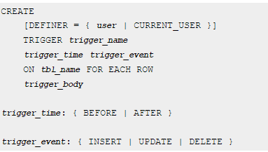
Parts of the trigger in more detail:
NOTES:
you cannot have multiple triggers for a given table that have the same trigger event and action time, e.g. you can’t have 2 BEFORE INSERT triggers BUT you can have a BEFORE and AFTER trigger or a BEFORE INSERT and BEFORE UPDATE triggers

Slide 7
Granularity:
FOR EACH ROW: the trigger is activated every time a row is changed
Trigger Condition:
similar to the WHERE clause in an SQL statement.
If you do not have a trigger condition, the trigger’s body executes every time the trigger is activated.

Slide 8
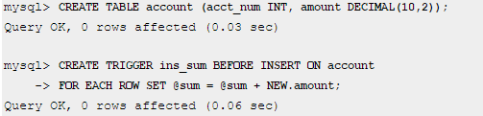
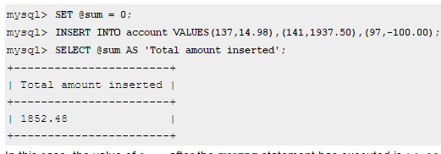
Another Example:

Slide 9
Another Example:
test1
test2
CREATE TABLE test1(a1 INT);
CREATE TABLE test2(a2 INT);
CREATE TABLE test3(a3 INT NOT NULL AUTO_INCREMENT PRIMARY KEY);
CREATE TABLE test4(
a4 INT NOT NULL AUTO_INCREMENT PRIMARY KEY,
b4 INT DEFAULT 0
);
delimiter |
CREATE TRIGGER testref BEFORE INSERT ON test1
FOR EACH ROW
BEGIN
INSERT INTO test2 SET a2 = NEW.a1;
DELETE FROM test3 WHERE a3 = NEW.a1;
UPDATE test4 SET b4 = b4 + 1 WHERE a4 = NEW.a1;
END;
|
delimiter ;
INSERT INTO test3 (a3) VALUES (NULL), (NULL), (NULL), (NULL), (NULL), (NULL), (NULL), (NULL), (NULL), (NULL);
INSERT INTO test4 (a4) VALUES (0), (0), (0), (0), (0), (0), (0), (0), (0), (0);
INSERT INTO test1 VALUES (1), (3), (1), (7), (1), (8), (4), (4);
SELECT * from test1;
SELECT * from test2;
SELECT * from test3;
SELECT * from test4;
a1
a2
test3
test4
a3
a4 | b4
 | 0

Slide 10
Another Example Continued:
Now try this out in your Virtual Machine
vetoffice=> INSERT INTO test3 (b3) VALUES ('cow'), ('cow'), ('cow'), ('cow'), ('cow'), ('cow'), ('cow'), ('cow'), ('cow'), ('cow');
INSERT 0 10
vetoffice=> SELECT * FROM test3;
a3 | b3
----+-----
1 | cow
2 | cow
3 | cow
4 | cow
5 | cow
6 | cow
7 | cow
8 | cow
9 | cow
10 | cow
(10 rows)
vetoffice=> INSERT INTO test4 (b4) VALUES (0), (0), (0), (0), (0), (0), (0), (0), (0), (0);
INSERT 0 10
vetoffice=> SELECT * FROM test4;
a4 | b4
----+----
1 | 0
2 | 0
3 | 0
4 | 0
5 | 0
6 | 0
7 | 0
8 | 0
9 | 0
10 | 0
(10 rows)
vetoffice=> INSERT INTO test1 VALUES (1), (3), (1), (7), (1), (8), (4), (4);
INSERT 0 8
vetoffice=> SELECT * from test1;
a1
----
1
3
1
7
1
8
4
4
(8 rows)
vetoffice=> SELECT * from test2;
a2
----
1
3
1
7
1
8
4
4
(8 rows)
vetoffice=> SELECT * from test3;
a3 | b3
----+-----
2 | cow
5 | cow
6 | cow
9 | cow
10 | cow
(5 rows)
vetoffice=> SELECT * from test4;
a4 | b4
----+----
2 | 0
5 | 0
6 | 0
9 | 0
10 | 0
3 | 1
7 | 1
1 | 3
8 | 1
4 | 2
(10 rows)

Slide 11
QUESTION: Assume we have the tables:
STUDENT(Student_Num, LastName, …Age)
UNIV_STATS(Num_of_Students, Total_Age, Average_Age, …)
Write a trigger that will keep the UNIV_STATS table accurate:
CREATE TRIGGER keeptotalscorrectup AFTER INSERT ON student FOR EACH ROW EXECUTE PROCEDURE addtocount()
CREATE TRIGGER keeptotalscorrectdown AFTER DELETE ON student FOR EACH ROW EXECUTE PROCEDURE minusfromcount()

